Slide 1
Interim presentation
FINANCIAL ANALYSIS
Date of presentation: 08/07/2024
01/07/2024

Slide 2
TEAM DETAILS
Name of team: Team Blue
Name of Mentor: Pravindra Kumar Gole
Team Members:
1. Kamutam Sai Nandu
2. Chinthapula Sharath Kumar
3. Kotha Vishwak
4. Kanneganti Neharsha Vishnu
5. Kamparaju Siddharth
6. Janjanam Nithin Teja
Team Lead: Kamutam Sai nandu

Slide 3
All Milestones
4-6-24
Kick off meeting
Developing Project Plan
12-6-24
Requirements Gathering and Analysis
Developing Use Cases
19-6-24
Designing System Architecture
Designing User Interfaces
26-6-24
Setting up Development Environment
29-6-24
Backend Development
3-7-24
Providing Insights
Frontend Development
User Authentication

Slide 4
Milestones completed with date
Sl.No | Milestone | Details of work/Task related to the milestones | Date of completion | Who was involved in completing each of the tasks | Which technologies has been used
1 | Project plan | Understanding the project, technologies , roles and responsibilities | 11/06/2024 | Entire Team | Jira
2 | Front-End | Developing user interface , Dashboard, profile | 01/07/2024 | Sharath Kumar, Siddharth, Nithin Teja | React
3 | Back-End | Generating graphs, Analyzing Data | 05/07/2024 | Sai Nandu, Vishnu, Vishwak | Python, Flask
Milestone Tracker: https://docs.google.com/spreadsheets/d/1LiL3LVLmr0IfnACWLJWhtdICsuCq5GsRwpKW1JyJOhc/edit?usp=sharing

Slide 5
Pending milestones with possible dates of completion
Sl. No. | Milestone | Details of work / Tasks related to the pending milestones | Date of possible completion | Who will complete each of the tasks? | What technology will you use?
1 | Developing API | Technology stack, Endpoints, Authentication | 16/07/2024 | Sai Nandu, Vishnu | REST Api
2 | Integrating Frontend and Backend | Defining endpoints, making http requests, Deployment | 19/07/2024 | Sai Nandu, Vishwak | React, Vue.js, Python, Flask, MySQL
3 | Testing & Debugging | Unit Testing, Integration Testing, Performance Testing | 22/07/2024 | Sharath, Sai nandu, Nithin Teja | Postman, pytest
4 | Deployment | Cloud platform | 25/07/2024 | Siddharth, Sai nandu | Google cloud/ AWS

Slide 6
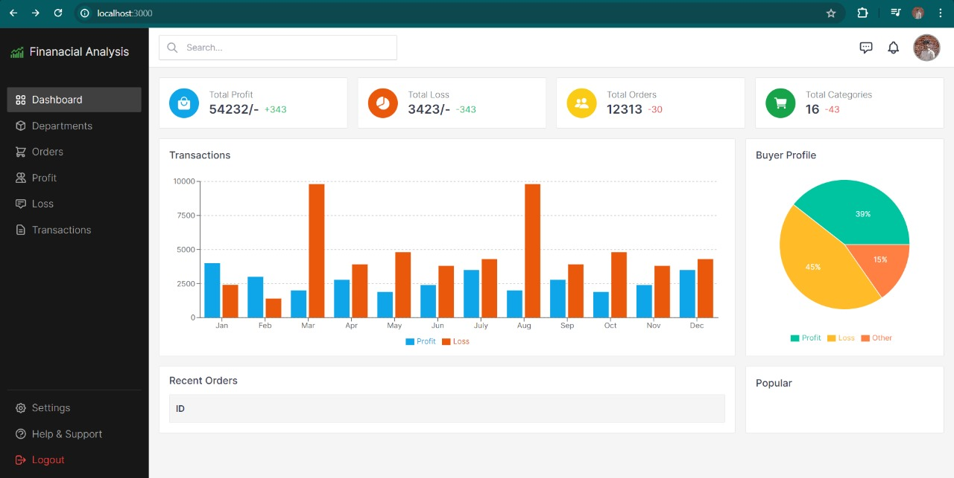
Details of work done
FRONTEND HOMEPAGE:
The dashboard displays a variety of financial metrics, including
Total Expenditure
Total Revenue
Current Status
Gross profit
Net Profit
The dashboard provides a quick
overview of a company's financial
performance.

Slide 7
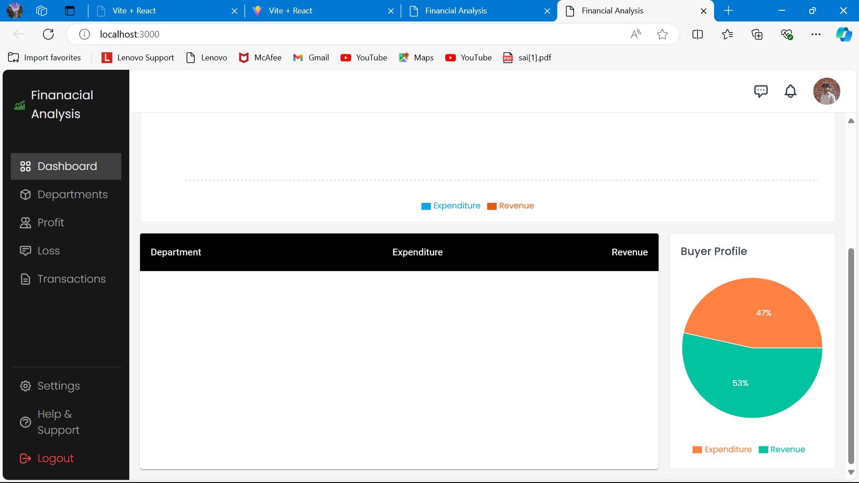
Department wise expenditure
The page provides expenditure and revenue breakdown department wise and displays a pie chart for better understanding.
This gives us an idea of which department is taking more expenditure and which department is generating more revenue

Slide 8
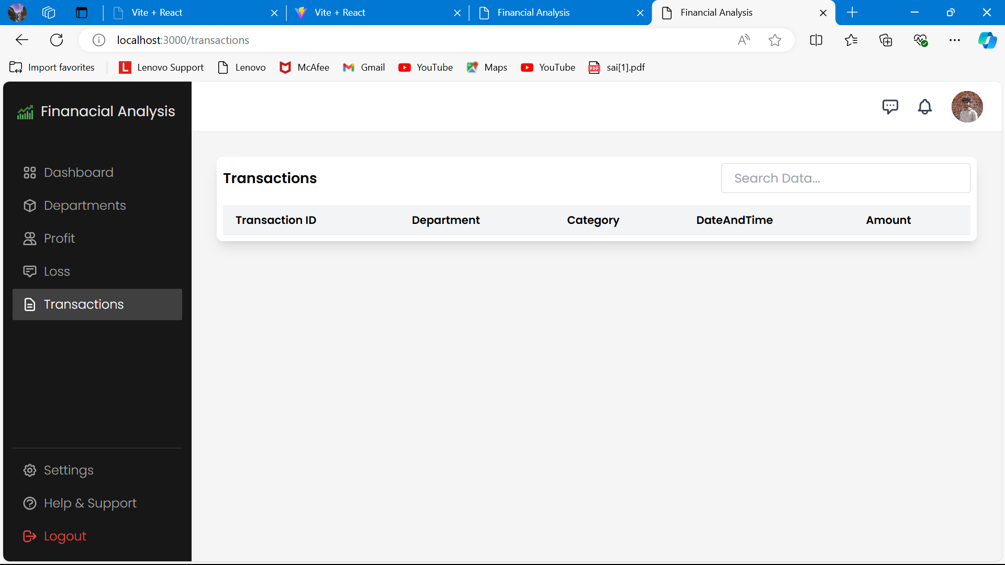
Transaction Section
Transaction section provides every transaction the company have done .
The body of the webpage shows a table with the details:
Transaction ID
Department
Category
Date and Time
Amount

Slide 9
References used for the project work
Flask tutorials: https://youtu.be/oQWkuJhSMCQ?feature=shared
Flask Docs: https://flask.palletsprojects.com/en/3.0.x/
Python libraries for financial analysis: https://medium.com/@awaleedpk/top-python-libraries-for-financial-analysis-in-2024-b3b18c1e7efb
Importing and Visualizing financial data in Python: https://medium.com/@kt.26karanthakur/importing-and-visualising-financial-data-in-python-0bc560ea0259
React tutorials: https://youtu.be/1r79Eqw6tfg?feature=shared

